Slide 1
Chapter 12 Power Amplifiers
12.1 General Considerations
12.2 Classification of Power Amplifiers
12.3 High-Efficiency Power Amplifiers
12.4 Cascode Output Stages
12.5 Large-Signal Impedance Matching
12.6 Basic Linearization Techniques
12.7 Polar Modulation
12.8 Outphasing
12.9 Doherty Power Amplifier
12.10 Design Examples
Behzad Razavi, RF Microelectronics.
Prepared by Bo Wen, UCLA

Slide 2
Chapter Outline
Basic PA Classes
High Efficiency PAs
Class A PAs
Class B PAs
Class C PAs
Class A PAs with Harmonic Enhancement
Class E PAs
Class F PAs
PA Design Examples
Linearization Techniques
Cascode PAs
Positive-Feedback PAs
PAs with Power Combining
Polar Modulation PAs
Outphasing PAs
Feedforward
Cartesian Feedback
Predistortion
Polar Modulation
Outphasing
Doherty PA

Slide 3
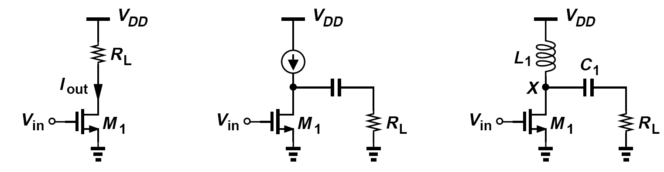
The Trade-Off between the Output Power and the Voltage Swing
For a common-source (or common-emitter) stage to drive the load directly, a supply voltage greater than V_{pp} is required.
If the load is realized as an inductor, the drain ac voltage exceeds V_{DD}, even reaching 2V_{DD} (or higher). But the maximum drain-source voltage experienced by M₁ is still at least 20 V if the stage must deliver 1 W to a 50-Ω load.
It can be proven that the product of the breakdown voltage and f_{T} of silicon devices is around 200 GHz·V.

Slide 4
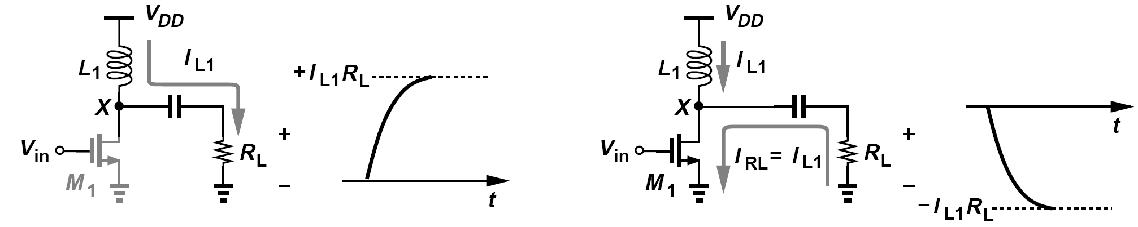
Example of RF Choke
What is the peak current carried by M₁ in figure below? Assume L₁ is large enough to act as an ac open circuit at the frequency of interest, in which case it is called an “RF choke” (RFC).
Solution:
If L₁ is large, it carries a constant current, I_{L1} (why?). If M₁ begins to turn off, this current flows through R_{L}, creating a positive peak voltage of I_{L1}R_{L}. Conversely, if M₁ turns on completely, it must “sink” both the inductor current and a negative current of I_{L1} from R_{L} so as to create a peak voltage of -I_{L1}R_{L}. The peak current through the output transistor is therefore equal to 400 mA.

Slide 5
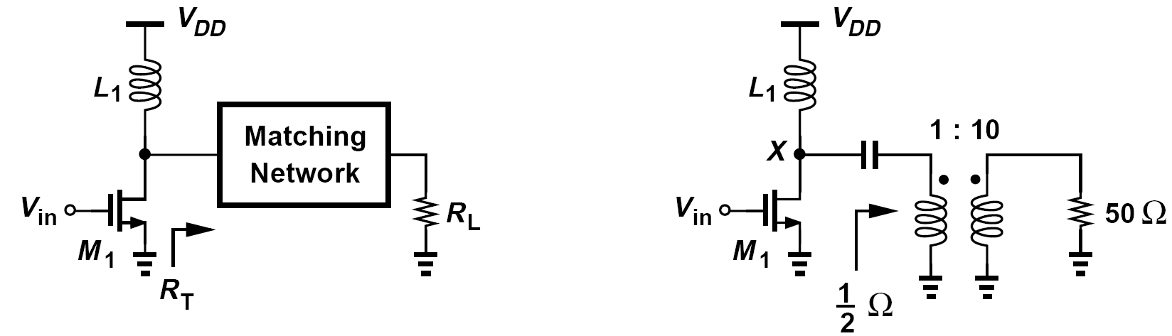
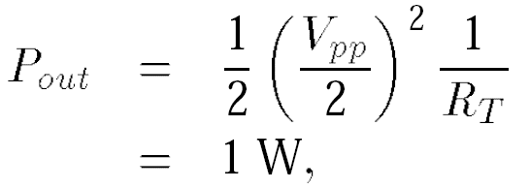
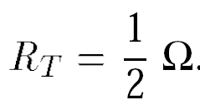
Interposing a Matching Network
In order to reduce the peak voltage experienced by the output transistor, a “matching network” is interposed between the PA and the load. This network transforms the load resistance to a lower value, R_{T} , so that smaller voltage swings still deliver the required power.
The above PA must deliver 1 W to R_{L} = 50 Ω with a supply voltage of 1 V. Estimate the value of R_{T.}
The peak-to-peak voltage swing, V_{pp}, at the drain of M₁ is approximately equal to 2 V. Since:
The matching network must therefore transform R_{L} down by a factor of 100. Figure above shows an example, where a lossless transformer having a turns ratio of 1:10 converts a 2-V_{pp} swing at the drain of M₁ to a 20-V_{pp} swing across R_{L}.

Slide 6
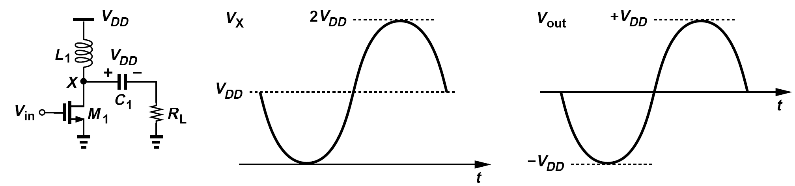
Example of Inductive-Loaded CS Stage
Plot V_{X} and V_{out} in figure below as a function of time if M₁ draws enough current to bring V_{X} near zero. Assume sinusoidal waveforms. Also, assume L₁ and C₁ are ideal and very large.
Solution:
In the absence of a signal, V_{X} = V_{DD} and V_{out} = 0. Thus, the voltage across C₁ is equal to V_{DD}. We also observe that, in the steady state, the average value of V_{X} must be equal to V_{DD} because L₁ is ideal and therefore must sustain a zero average voltage. That is, if V_{X} goes from V_{DD} to near zero, it must also go from V_{DD} to about 2V_{DD} so that the average value of V_{X} is equal to V_{DD} . The output voltage waveform is simply equal to V_{X} shifted down by V_{DD.}

Slide 7
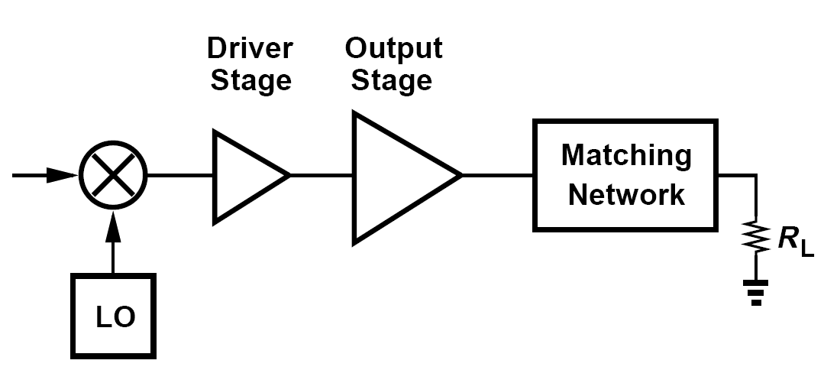
Effect of High Currents
If the output transistor is chosen wide enough to carry a large current, then its input capacitance is very large, making the design of the preceding stage difficult.
We may deal with this issue by interposing a number of tapered stages between the upconversion mixer(s) and the output stage.
Another issue arising from the high ac currents in PAs relates to the package parasitic.
The large currents can also lead to a high loss in the matching network.

Slide 8

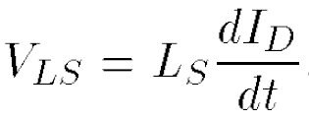

Example of Package Parasitics
The output transistor in previous example with a transformer carries a current varying between 0 and 4 A at a frequency of 1 GHz. What is the maximum tolerable bond wire inductance in series with the source of the transistor if the voltage drop across this inductance must remain below 100 mV?
Solution:
The drain current of M₁ can be approximated as
where I₀ = 2 A and ω₀ = 2π(1 GHz). The voltage drop across the source inductance, L_{S}, is given by
reaching a peak of L_{S}ω₀I₀. For this drop to remain below 100 mV, we have
This is an extremely small inductance.(A single bond wire’s inductance typically exceeds
1 nH)

Slide 9
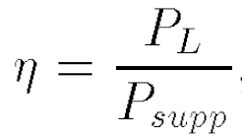
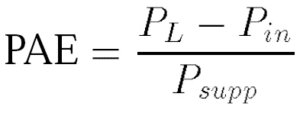
Efficiency
The “drain efficiency” (for FET implementations) or “collector efficiency” (for
bipolar implementations) is defined as:
where P_{L} denotes the average power delivered to the load and P_{supp} the average power drawn from the supply voltage.
“Power-added efficiency”, PAE, defined as
where P_{in} is the average input power
Discuss the PAE of the CS stage.
At low to moderate frequencies, the input impedance is capacitive and hence the average input power is zero. (Of course, driving a large capacitance is still difficult.) Thus, PAE = η. At high frequencies, the feedback due to the gate-drain capacitance introduces a real part in Z_{in}, causing the input port to draw some power. Consequently, PAE < η. In stand-alone PAs, we may deliberately introduce a 50-Ω input resistance, in which case PAE < η.

Slide 10
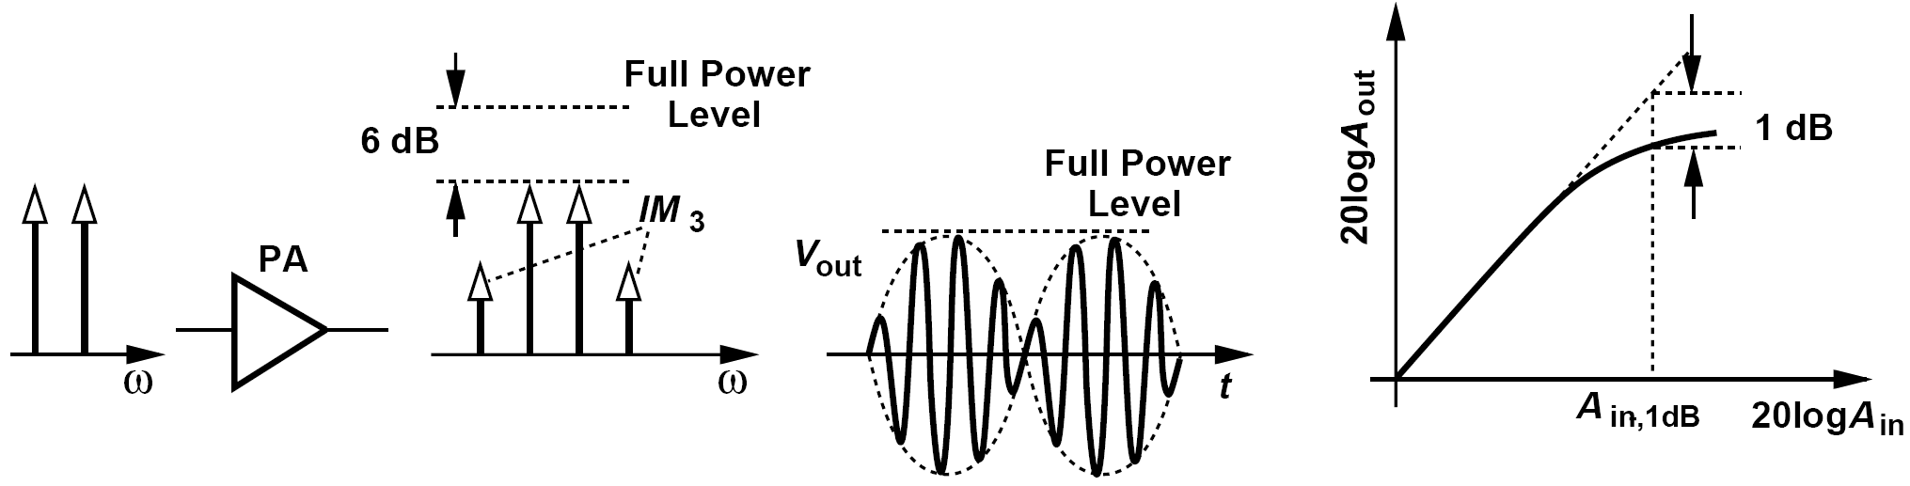

Linearity: PA Characterization
The PA characterization begins with two generic tests of nonlinearity based on unmodulated tones: intermodulation and compression.
A more rigorous characterization: suppose the modulated input is of the form:
The output can be written as:
Assume both A(t) and Φ(t) are nonlinear static functions of only the input amplitude, a(t)

Slide 11
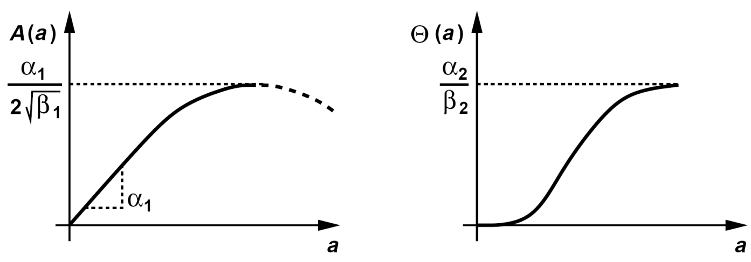
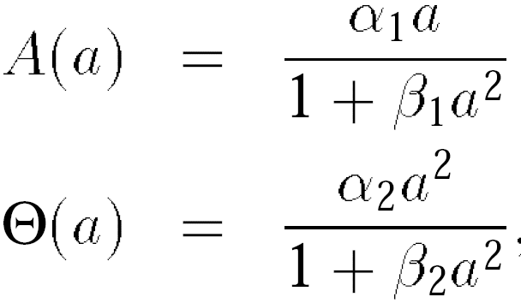
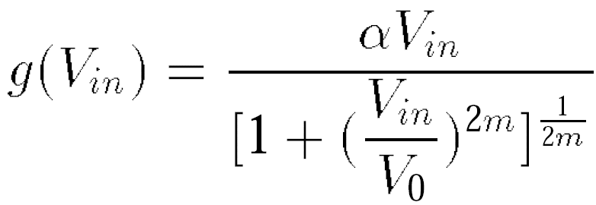
AM/AM Conversion and AM/PM Conversion and Rapp Model
A[a(t)] and Φ[a(t)] represent “AM/AM conversion” and “AM/PM conversion”, respectively
For a cascade of stages, the overall model may be quite complex and the behavior of A and Φ quite different.
Another PA nonlinearity representation, called the “Rapp model”, is expressed as follows:
Dealing with only static nonlinearity, this model has become popular in integrated PA design. We return to it in Chapter 13.

Slide 12
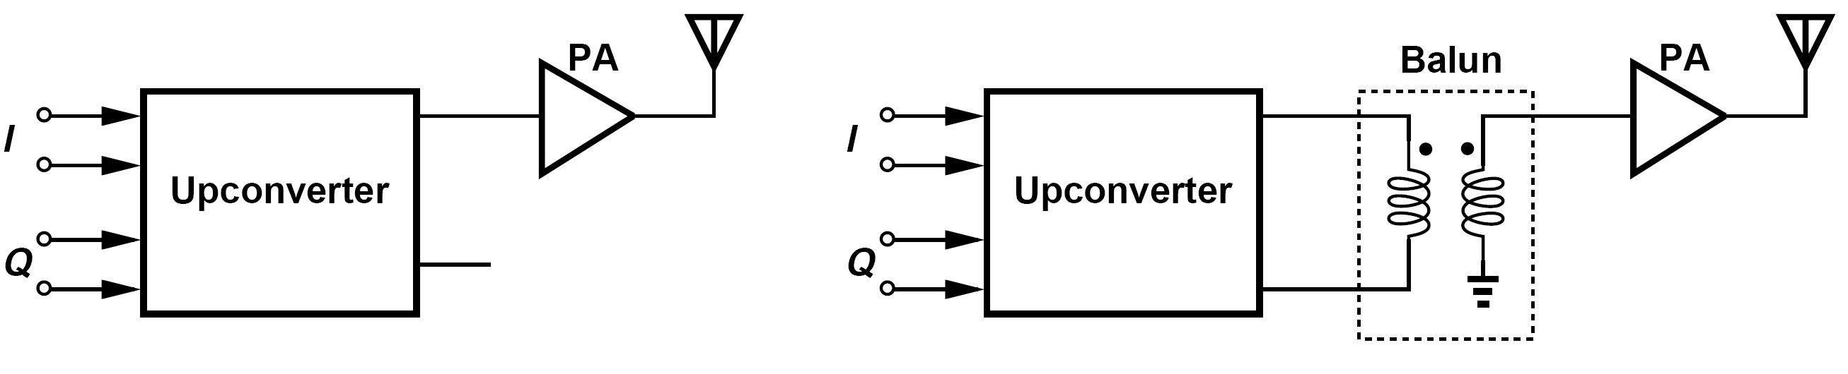
Single Ended PAs (Ⅰ)
Advantages of single ended PAs: the antenna is typically single-ended, and single-ended RF circuits are much simpler to test than their differential counterparts.
Drawback No.1: they “waste” half of the transmitter voltage gain because they sense only one output of the upconverter.
This issue can be alleviated by interposing a balun between the upconverter and the PA. But balun introduces its own loss.

Slide 13
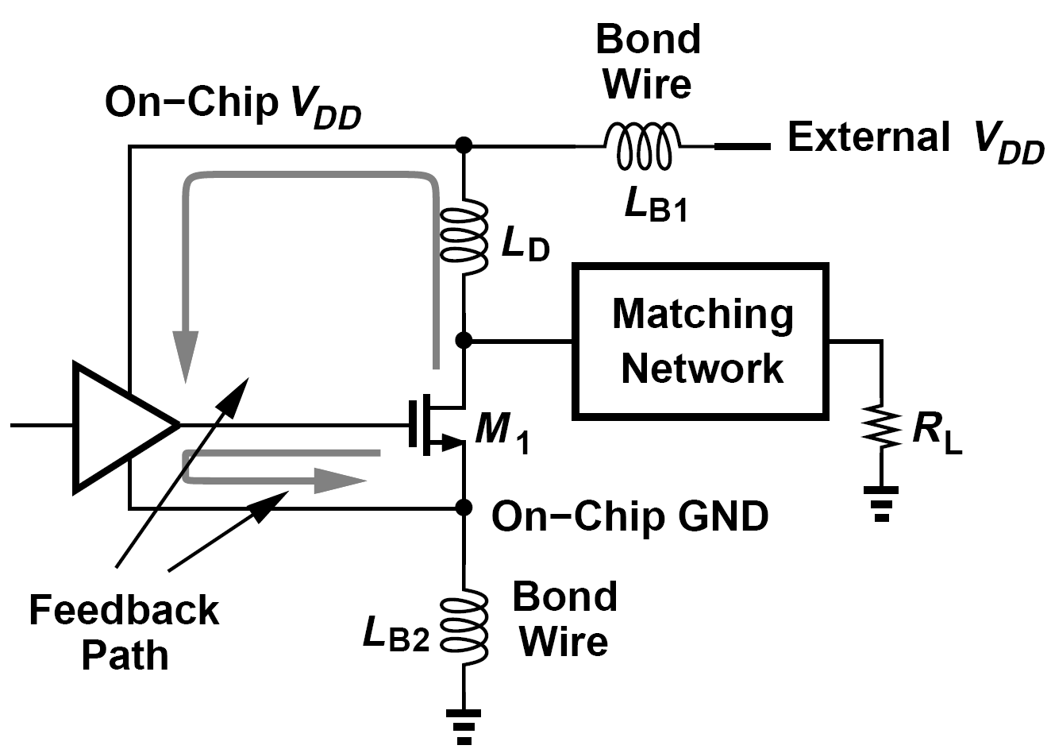
Single Ended PAs (Ⅱ)
Drawback No.2 stems from the very large transient currents that they pull from the supply to the ground.
L_{B1} alters the resonance or impedance transformation properties of the output network if it is comparable with L_{D}. L_{B1} allow some of the output stage signal to travel back to the preceding stages. L_{B2} degenerates the output stage and introduces feedback.

Slide 14
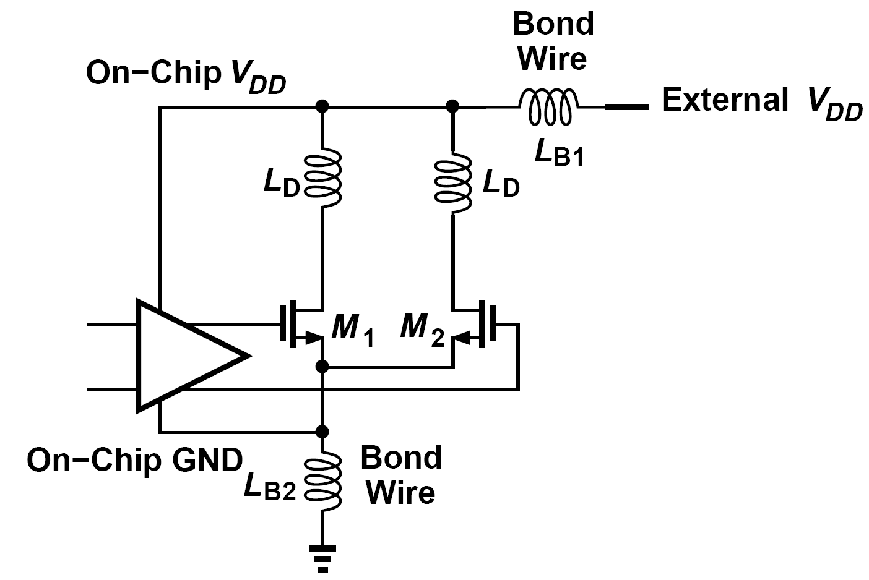
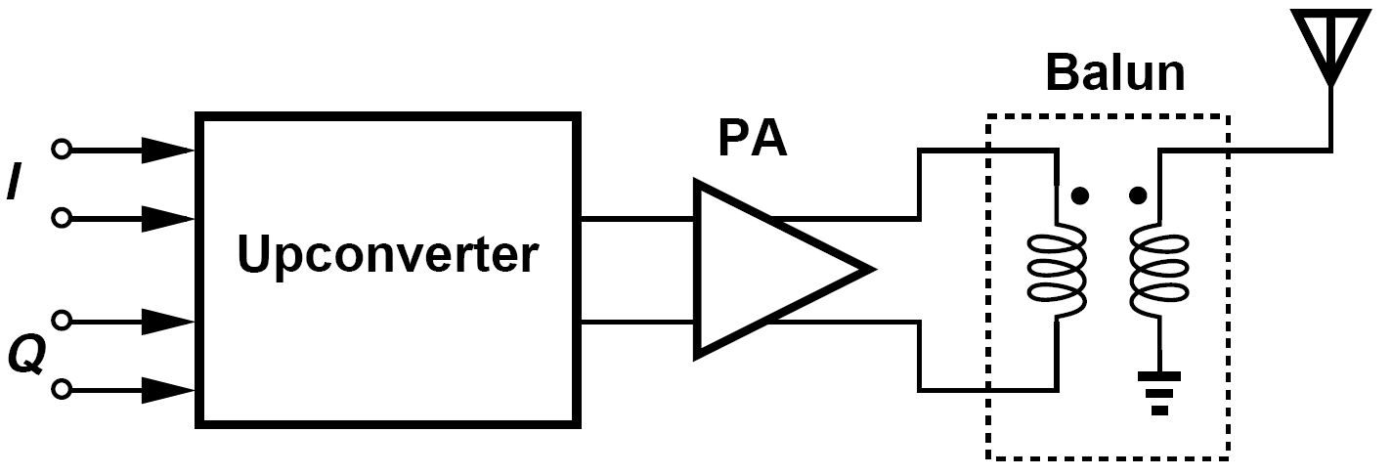
Differential PAs
A differential realization draws much smaller transient currents from V_{DD} and ground lines, exhibiting less sensitivity to L_{B1} and L_{B2} and creating less feedback. The degeneration issue is also relaxed considerably.
While the use of a differential PA ameliorates both the voltage gain and package parasitic issues, the PA must still drive a single-ended antenna in most cases. Thus, a balun must now be inserted between the PA and the antenna.

Slide 15
Example of Efficiency and Loss in Balun Design
Suppose a given balun design has a loss of 1.5 dB. In which one of the transmitters shown before (one with balun preceding PA and one after PA)does this loss affect the efficiency more adversely?
Solution:
In the former case, the balun lowers the voltage gain by 1.5 dB but does not consume much power. For example, if the power delivered by the upconverter to the PA is around 0 dBm, then a balun loss of 1.5 dB translates to a heat dissipation of 0.3 mW. In the latter one, on the other hand, the balun experiences the entire power delivered by the PA to the load, dissipating substantial power. For example, if the PA output reaches 1 W, then a balun loss of 1.5 dB corresponds to 300 mW. The TX efficiency therefore degrades more significantly in the latter case.

Slide 16
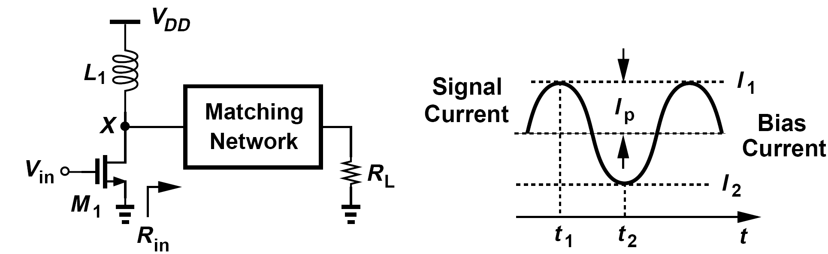
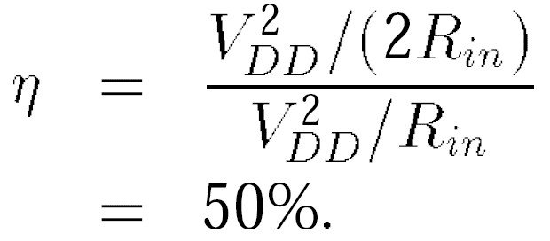
Classification of Power Amplifiers: Class A Power Amplifiers
Class A amplifiers are defined as circuits in which the transistor(s) remain on and operate linearly across the full input and output range.
If linearity is required, then class A operation is necessary.
The maximum drain efficiency of class A amplifiers:

Slide 17
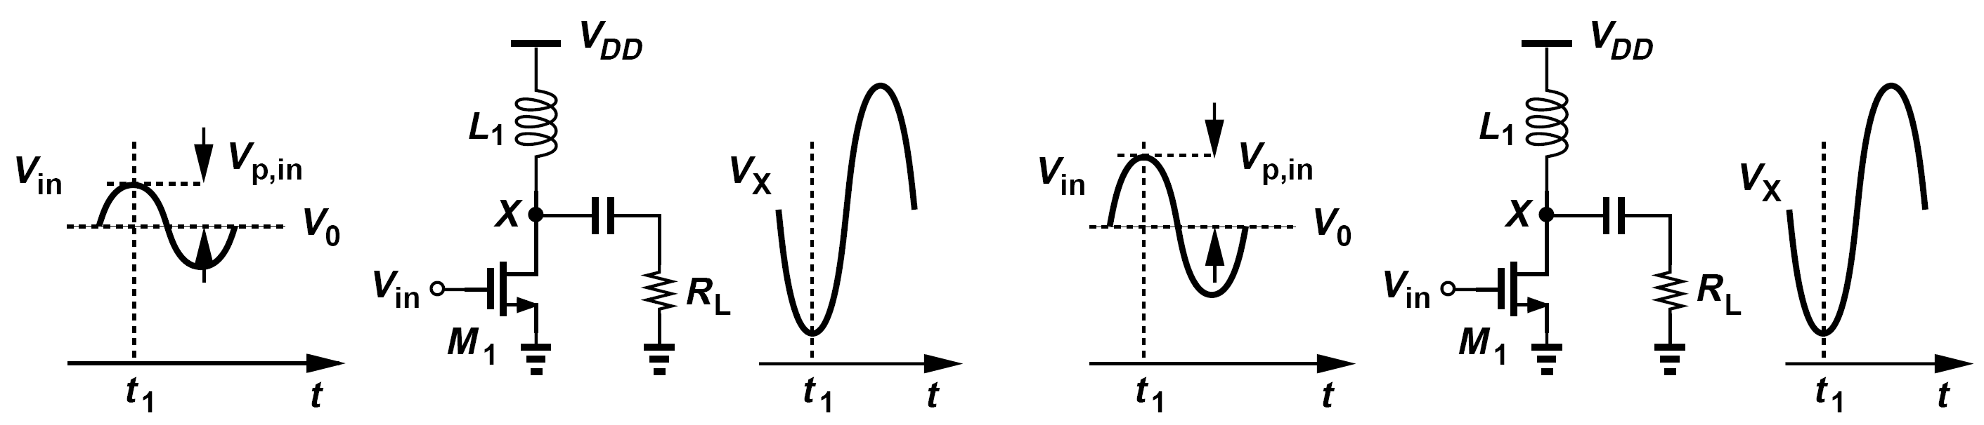
Examples of Class A Power Amplifiers
Is the foregoing calculation of efficiency consistent with the assumption of linearity in class A stages?
No, it is not. With a sinusoidal input, V_{X} reaches 2V_{DD} only if the transistor turns off. This ensures that the current swing delivered to the load goes from zero to twice the bias value.
Explain why low-gain output stages suffer from a more severe efficiency-linearity trade-off.
Consider the two scenarios depicted in figure below. In both cases, for M₁ to remain in saturation at t = t₁, the drain voltage must exceed V₀ + V_{p,in} - V_{TH}. In the high-gain stage, V_{p,in} is small, allowing V_{X} to come closer to zero than in the low-gain stage.

Slide 18
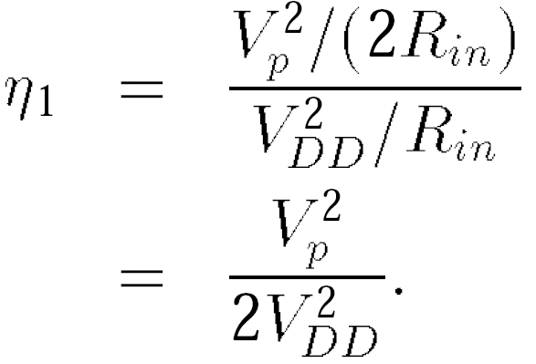
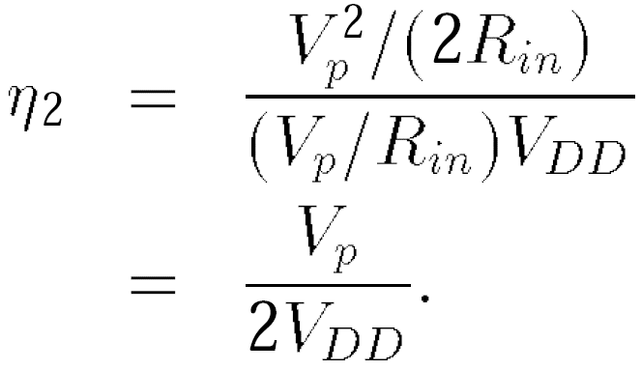
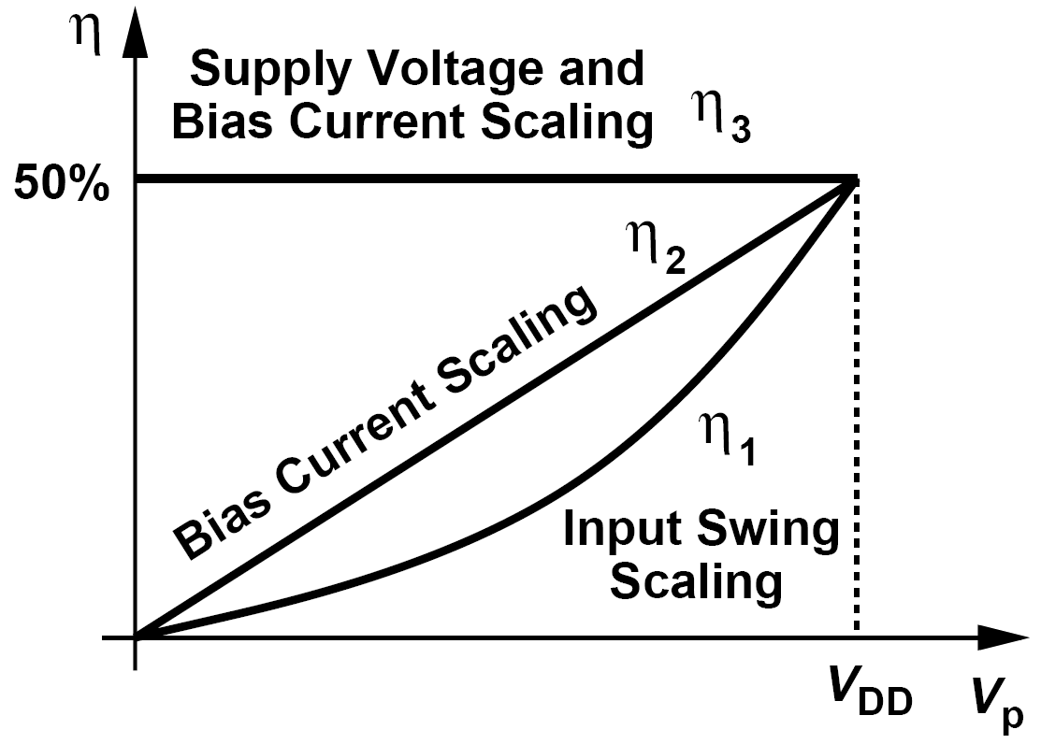

Efficiency in Different Scaling Scenarios
(1)The supply voltage and bias current remain at the levels necessary for full output power and only the input signal swing is reduced:
(2)The supply voltage remains unchanged but the bias current is reduced in proportion to the output voltage swing:
(3)Both the supply voltage and the bias current are reduced in proportion to the output voltage swing:

Slide 19
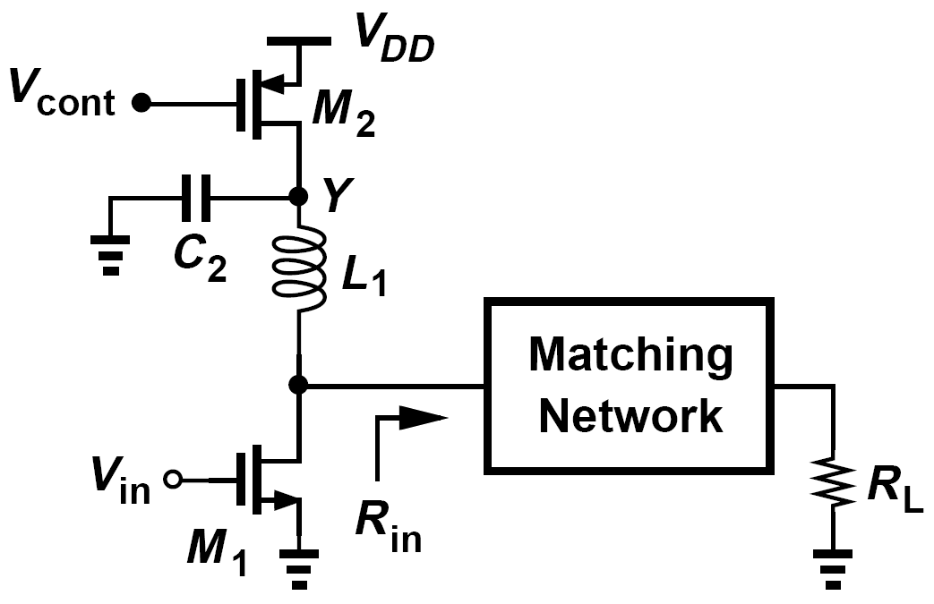
Example of Output Stage with Variable Supply Voltage
A student attempts to construct an output stage with a variable supply voltage as shown below. Here, M₂ operates in the triode region, acting as a voltage-controlled resistor, and C₂ establishes an ac ground at node Y . Can this circuit achieve an efficiency of 50%?
Solution:
No, it cannot. Unfortunately, M₂ itself consumes power. If the bias current is chosen equal to V_{p}=R_{in}, then the total power drawn from V_{DD} is still given by (V_{p}/R_{in})V_{DD} regardless of the on-resistance of M₂. Thus,M₂ consumes a power of (V_{p}/R_{in})R_{on2}, where R_{on2} denotes its on-resistance.

Slide 20
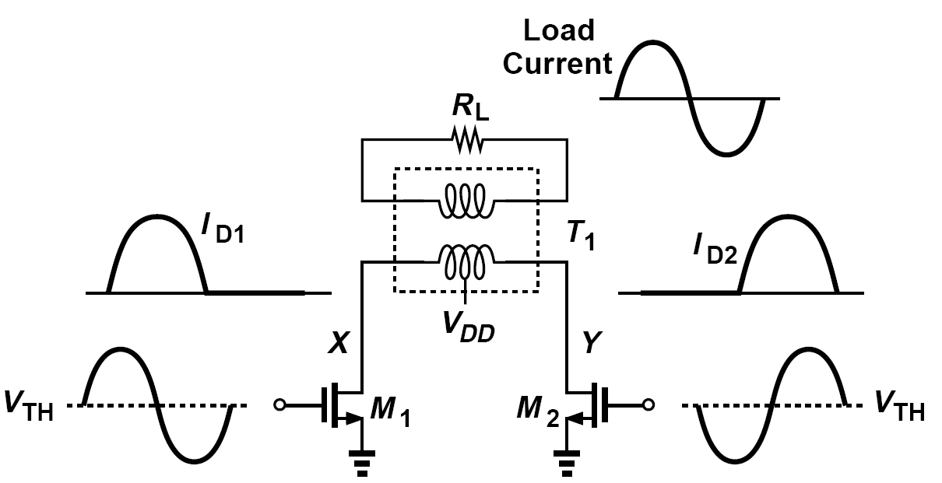
Class B Power Amplifier
Conduction Angle is defined as the percentage of the signal period during which the transistor remain on multiplied by 360 °
The traditional class B PA employs two parallel stages each of which conducts for only 180°, thereby achieving a higher efficiency than the class A counterpart.

Slide 21
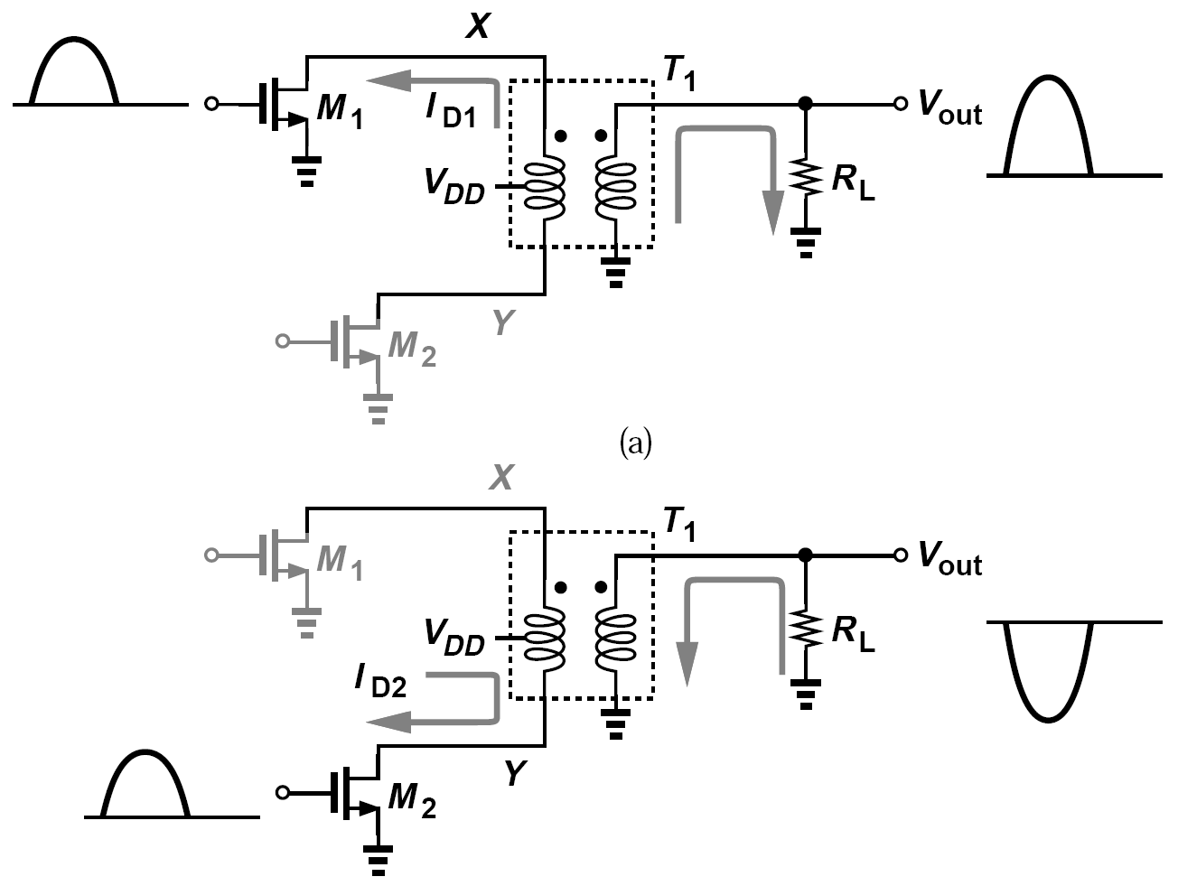
Example of Class B Amplifier
Explain how T₁ combines the half-cycle current waveforms generated by M₁ and M₂
Solution:
Using superposition, we draw the output network in the two half cycles as shown here. When M₁ is on, I_{D1} flows from node X, producing a current in the secondary that flows into R_{L} and generates a positive V_{out} . Conversely, when M₂ is on and draws current from node Y , the secondary current flows out of R_{L} and generates a negative V_{out}

Slide 22
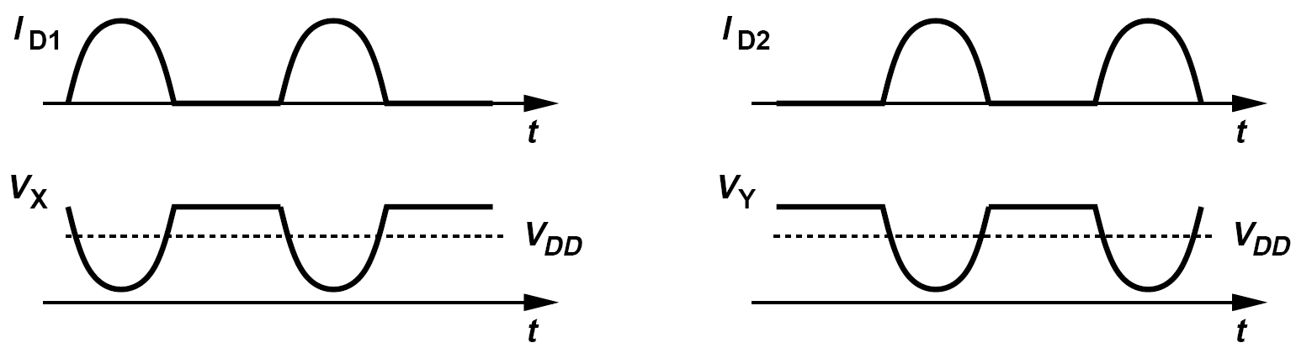
Issue of Output Swing of Class B PA/ Class AB PA
If the parasitic capacitances are small and the primary and secondary inductances are large, the swing above V_{DD} is approximately half that below V_{DD}, an undesirable situation resulting in a low efficiency.
For this reason, the secondary (or primary) of the transformer is tuned by a parallel capacitance.
The term “class AB” is sometimes used to refer to a single-ended PA (e.g., a CS stage) whose conduction angle falls between 180 ° and 360 °, i.e., in which the output transistor turns off for less than half of a period. From another perspective, a class AB PA is less linear than a class A stage and more linear than a class B stage.

Slide 23
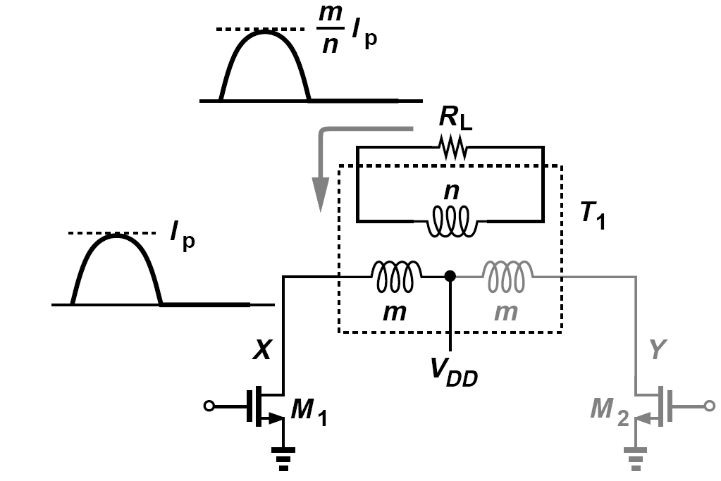
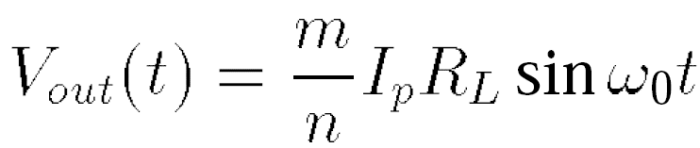
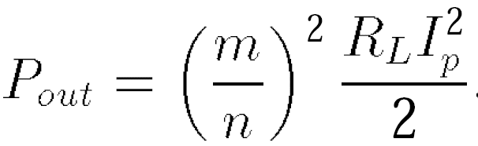
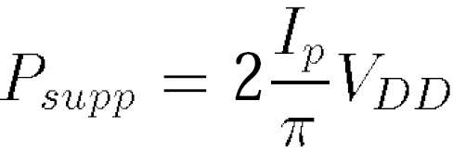
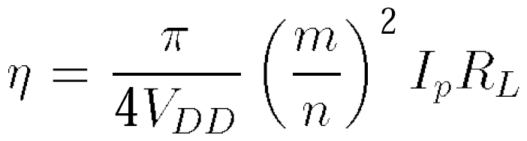
Calculation of Class B PA Efficiency(Ⅰ)
A half-cycle sinusoidal current, I_{D1} = I_{p}sinω₀t, producing an output voltage given by:
and delivering an average power of:
average power provided by V_{DD} is equal to:
Drain efficiency of class B stages:

Slide 24
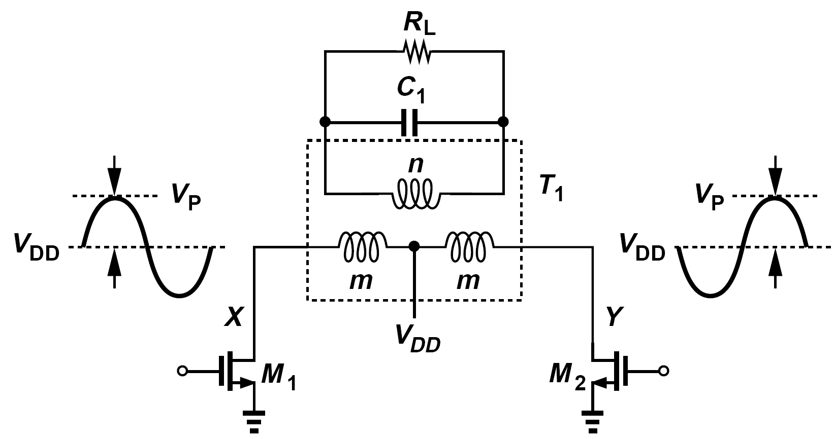
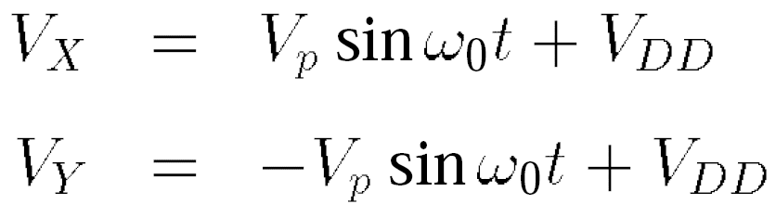

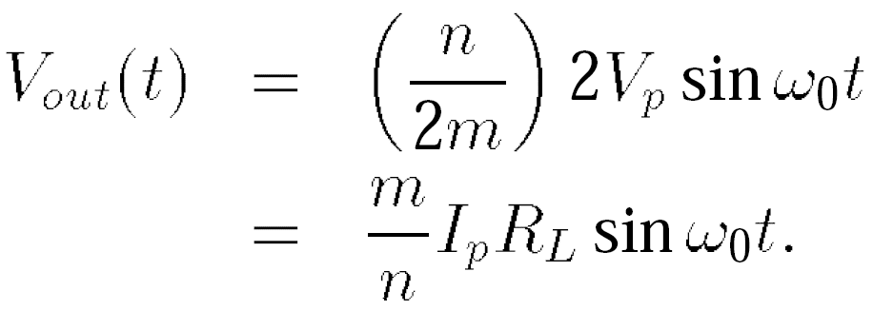
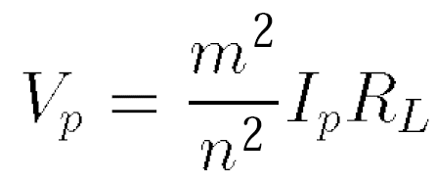
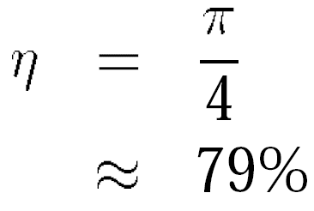
Calculation of Class B PA Efficiency(Ⅱ)
In our last step, we calculate the voltage swings at X and Y in the presence of a resonant load in the secondary (or primary).
The primary of the transformer therefore senses a voltage waveform given by
which, upon experiencing a ratio of n/(2m), yields the output voltage:
We choose V_{p} = V_{DD} to maximize the efficiency

Slide 25
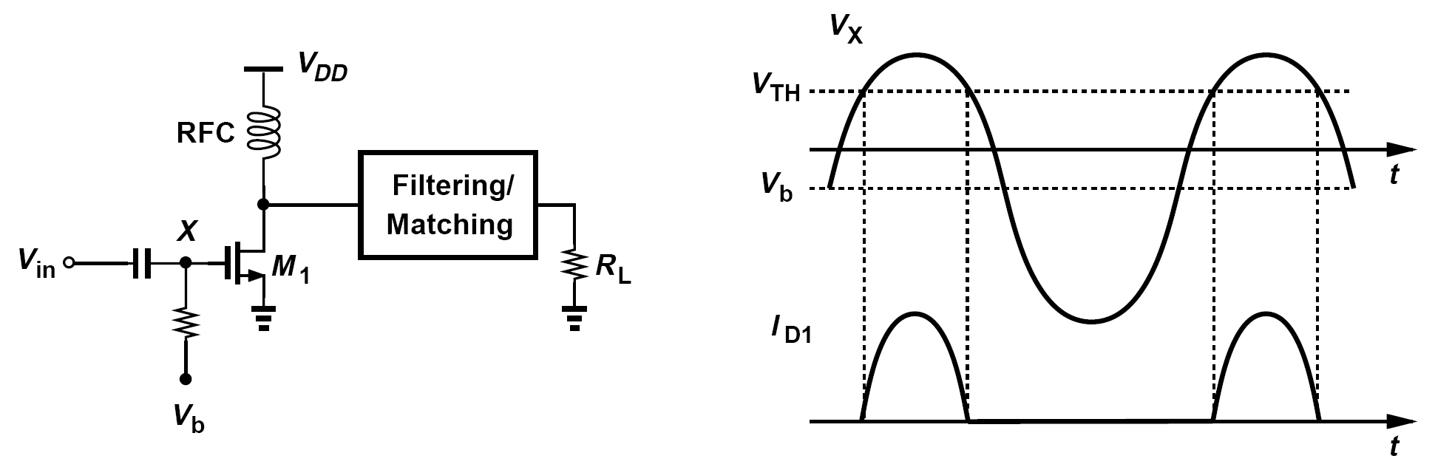
Class C Power Amplifiers: Overview
In class C stages, the conduction angle is further reduced. In order to avoid large harmonic levels at the antenna, the matching network must provide some filtering.
As θ decreases, the transistor is on for a smaller fraction of the period, thus dissipating less power. For the same reason, however, the transistor delivers less power to the load.

Slide 26
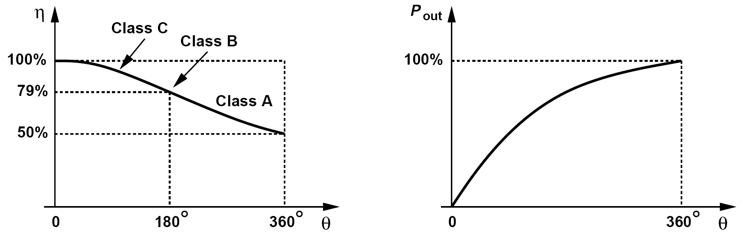
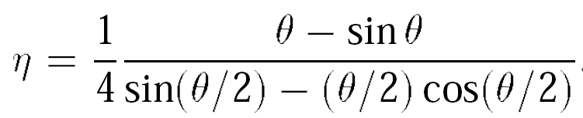
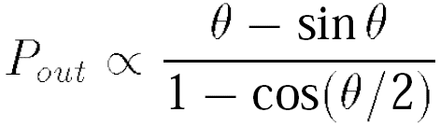
Efficiency of Class C Power Amplifiers
Efficiency of 100% as θ approaches zero.
P_{out} falls to zero as θ approaches zero.

Slide 27
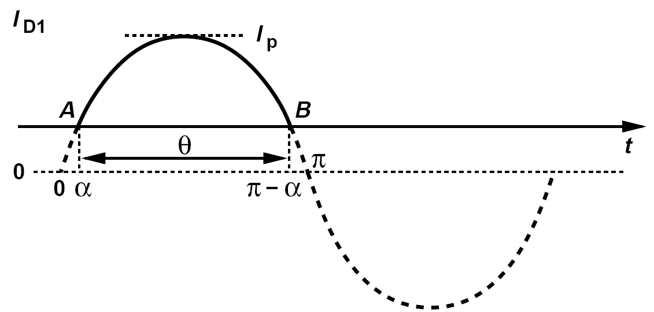
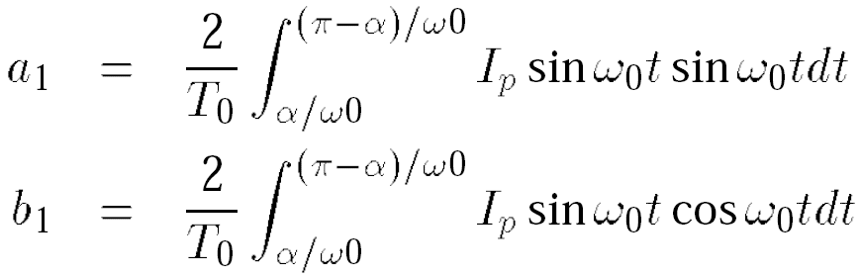
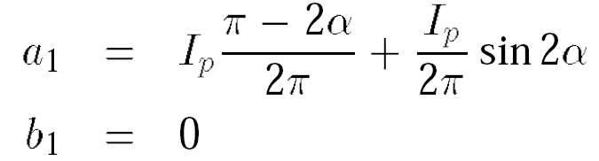

Example of Class C Stage Harmonic Calculation
Determine the amplitude of the first harmonic of the transistor drain current Class C stage for a conduction angle of θ.
Consider the waveform shown here, where conduction begins at point A and ends at point B. The angle of the sinusoid reaches α at A and π-α at B such that π-α-α= θ and hence α = (π-θ)/2. The Fourier coefficients of the first harmonic are obtained as
hence the first harmonic is expressed as
Note that a₁ → 0 as α → π/2. For example, if α = π/4, then a₁ ≈ 0:41I_{p}, the transistor must therefore be about 2.4 times as large as in a class-A stage for the same output power. Upon multiplication by R_{in}, this harmonic must yield a drain voltage swing of nearly 2V_{DD}.

Slide 28
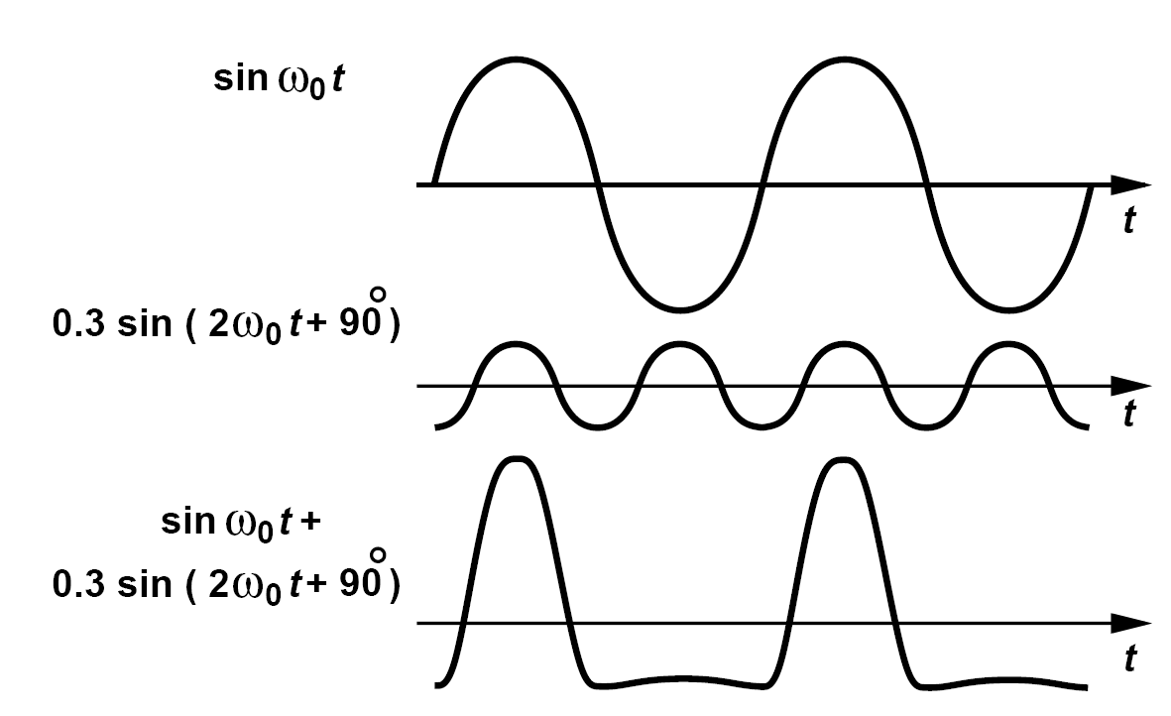
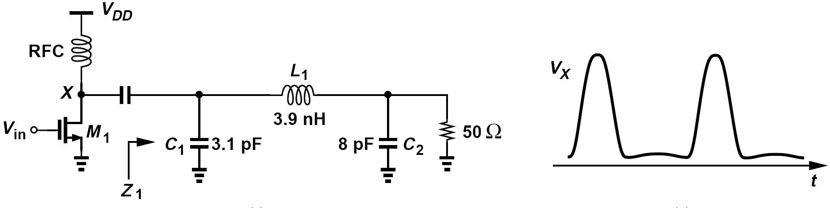
High-Efficiency Power Amplifiers: Class A Stage with Harmonic Enhancement
Suppose the matching network is designed such that its input impedance is low at the fundamental and high at the second harmonic.
The average power consumed by the output transistor decreases and the efficiency increases.

Slide 29
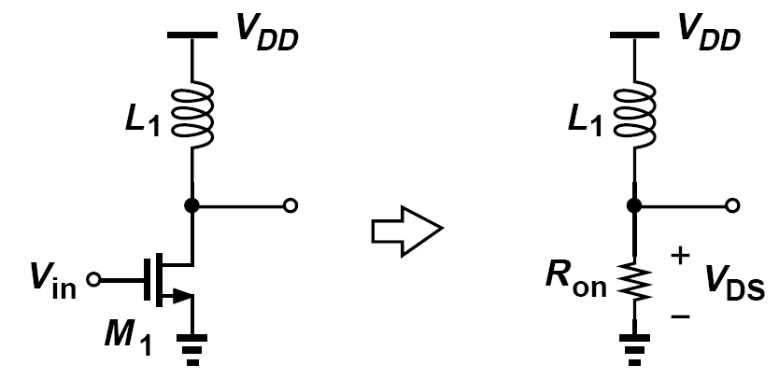
Class E Stage: Revisiting Output Stage with Switching Transistor
Class E stages are nonlinear amplifiers that achieve efficiencies approaching 100% while delivering full power, a remarkable advantage over class C circuits.
Called a “switching power amplifier,” such a topology achieves a high efficiency if :
(1) M₁ sustains a small voltage when it carries current,
(2) M₁ carries a small current when it sustains a finite voltage
(3) the transition times between the on and off states are minimized

Slide 30
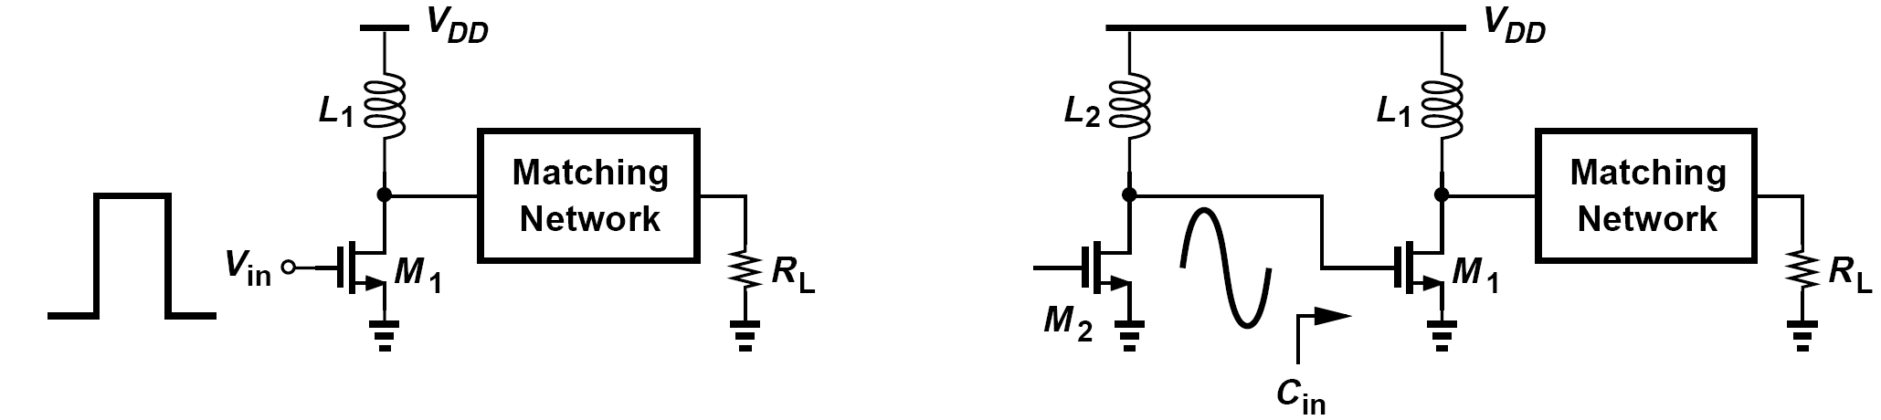
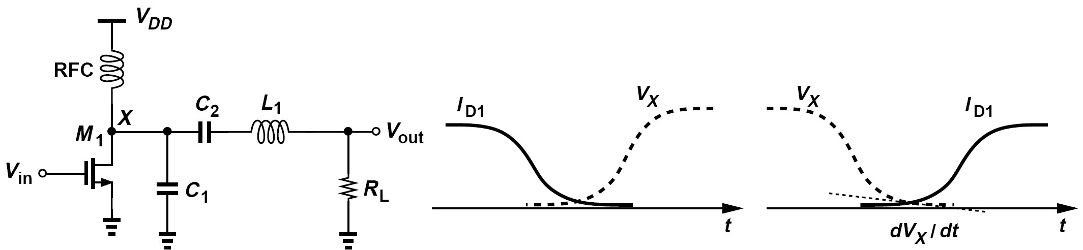
Dealing with Finite Input and Output Transitions
The gate of the output device must be switched as abruptly as possible to maximize the efficiency, but the large output transistor typically necessitates resonance at its gate, inevitably receiving a nearly sinusoidal waveform.
Class E amplifiers deal with the finite input and output transition times by proper load design.

Slide 31

Three Conditions Required for V_{x}
(1) As the switch turns off V_{X} remains low long enough for the current to drop to zero, i.e., V_{X} and I_{D1} have nonoverlapping waveforms. The first condition resolves the issue of finite fall time at the gate of M_{1.}
(2)V_{x} reaches zero just before the switch turns on. The second condition ensures that the V_{DS} and I_{D} of the switching device do not overlap in the vicinity of the turn-on point, thus minimizing the power loss.
(3)dV_{x} /dt is also near zero when the switch turns on. The third condition lowers the sensitivity of the efficiency to violations of the second condition.
The time response depends on the Q of the network and appears as shown above for underdamped, overdamped and critically-damped conditions.

Slide 32


Example of Class E Stage (Ⅰ)
Modeling a class E stage as shown below, plot the circuit’s voltages and currents
When M₁ turns on, it shorts node X to ground but carries little current because V_{X} is already near zero at this time (second condition described above). If R_{on1} is small, V_{X} remains near zero and L_{D} sustains a relatively constant voltage, thus carrying a current given by

Slide 33

Example of Class E Stage (Ⅱ)
Modeling a class E stage as shown below, plot the circuit’s voltages and currents
In other words, one half cycle is dedicated to charging L_{D} with minimal drop across M₁. When M₁ turns off, the inductor current begins to flow through C₁ and the load, raising V_{X}. This voltage reaches a peak at t = t₁ and begins to fall thereafter, approaching zero with a zero slope at the end of the second half cycle (second and third conditions described above). The matching network attenuates higher harmonics of V_{X}, yielding a nearly sinusoidal output.

Slide 34

Class F Power Amplifiers
If in the generic switching stage the load network provides a high termination impedance at the second or third harmonics, the voltage waveform across the switch exhibits sharper edges than a sinusoid, thereby reducing the power loss in the transistor. Such a circuit is called a class F stage.

Slide 35


Example of Class F Stage
Explain why a class B stage does not lend itself to third-harmonic peaking.
Solution:
If the output transistor conducts for half of the cycle, the resulting half-wave rectified current contains no third harmonic. The Fourier coefficients of the third harmonic are given by

Slide 36

Cascode Output Stages
One can choose V_{DD} equal to half of the maximum tolerable voltage of the transistor, but with two penalties: (a) the lower headroom limits the linear voltage range of the circuit, and (b) the proportionally higher output current (for a given output power) leads to a greater loss in the output matching network, reducing the efficiency.
The cascode device “shields” the input transistor as V_{x} rises, keeping the drain-source voltage of M₁ less than V_{b}- V_{TH2}.

Slide 37

Example of Cascode Stages
Determine the maximum terminal-to-terminal voltage differences of M₁ and M₂ in above cascode stage. Assume V_{in} has a peak amplitude of V₀ and a dc level of V_{m}, and V_{X} has a peak amplitude of V_{p} (and a dc level of V_{DD}).
Solution:
Transistor M₁ experiences maximum V_{DS} as V_{in} falls to V_{m} - V₀. If M₁ nearly turns off, then V_{DS1} ≈ V_{b} - V_{TH2}, V_{GS1} ≈ V_{m} - V₀, and V_{DG1} = V_{b} - V_{TH2} - (V_{m} - V₀). For the same input level, the drain voltage of M₂ reaches its maximum of V_{DD} + V_{p}, creating
and
Also, the drain-bulk voltage of M₂ reaches V_{DD} + V_{p}.

Slide 38


Linearity of Cascode Stages
From (a),
From (b),
It follows that,
The CS stage remains linear across a wider output voltage range than the cascode circuit does. At low supply voltages, cascode output stages offer only a slight voltage swing advantage over their CS counterparts, but at the cost of efficiency and linearity.

Slide 39




Example of Stability of Cascode Stages
Consider the two-stage PA shown below. If the output stage exhibits a negative input resistance, how can the cascade be designed to remain stable?
Drawing the Thevenin equivalent of the first stage as shown in (b), we observe that instability can be avoided if
so that V_{Thev} does not absorb energy from the circuit. If Z_{out} is modeled by a parallel tank, then
Thus, we require that
This condition must hold at all frequencies and for a certain range of R_{in}. For example, if a cellphone user wraps his/her hand around the antenna, R_{L} and hence R_{in} change.

Slide 40


Large-Signal Impedance Matching: the Simplistic Model and the Practical Model
This simplistic model assumed that the output matching network simply transforms R_{L} to a lower value.
In practice, the situation is more complex: a nonlinear complex output impedance must be matched to a linear load.

Slide 41





Large-Signal Impedance Matching: Starting from a Simple Case
Let us compute the power delivered by M₁ to R_{L}, P_{RL}, and that consumed by the transistor’s output resistance, P_{ro1}. We have
For maximum power transfer, R_{L} is chosen equal to r_{O1}, yielding P_{RL} = P_{ro1}.
Relation above shows that reducing RL minimizes the relative power consumed by the transistor.

Slide 42

Load-Pull Measurement
We vary Z₁ such that the power delivered to R_{L} remains constant and equal to P₁, thus obtaining the contour depicted above. Next, we seek those values of Z₁ that yield a higher output power, P₂, arriving at another contour. These “load-pull” measurements can be repeated for increasing power levels, eventually arriving at an optimum impedance, Z_{opt}, for the maximum output power.

Slide 43


Basic Linearization Techniques: Feedforward
The “feedforward” architecture computes the error and, with proper scaling, subtracts it from the output waveform.
Feedforward suffers from several shortcomings that have made its use in integrated PA design difficult.
(1) the analog delay elements introduce loss if they are passive or distortion if
they are active.
(2) the loss of the output subtractor degrades the efficiency
(3) the linearity improvement depends on the gain and phase matching of the
signals sensed by each subtractor

Slide 44


Examples of Addition of Signal in Current Domain and Nested Feedforward
A student surmises that the output subtraction need not introduce loss if it is performed in the current domain, e.g., as shown below. Explain the feasibility of this idea.
Since the main PA in the figure above is followed by a delay line and since performing delay in the current domain is difficult, the subtraction must inevitably occur in the voltage domain—and by means of passive devices. Thus, the idea is not practical. Other issues related to this concept are discussed later.
Considering the system in the previous slide as a “core” PA, apply another level of feedforward to further improve the linearity.
The core PA output is scaled by 1/A’_{v}, and a delayed replica of the main input is subtracted from it. The error is scaled by A’_{v} and summed with the delayed replica of the core PA output.

Slide 45




Example of Feedforward System
Suppose the main PA stage is completely nonlinear, i.e., its output transistor operates as an ideal switch. Study the effect of feedforward on the PA.
With the output transistor acting as an ideal switch, the PA removes the envelope of the signal, retaining only the phase modulation. If V_{in}(t) = V_{env}(t) cos[ω₀t + Φ(t)], then
where V₀ is constant. For such a nonlinear stage, it is difficult to define the voltage gain, A_{v}, because the output has little resemblance to the input. Nonetheless, let us proceed with feedforward correction: we divide V_{M} by A_{v}, obtaining

Slide 46

Cartesian Feedback
If the PA output is downconverted and compared with the baseband signal, an error term proportional to the nonlinearity of the transmitter chain can be created. With quadrature down conversion, this is called “Cartesian feedback”.
Cartesian feedback avoids the output subtractor and is much less sensitive to path mismatches, but requires some linearity in the PA.

Slide 47

Predistortion
If the PA nonlinear characteristics are known, it is possible to “predistort” the input waveform in such a manner that, after experiencing the PA nonlinearity, it resembles the ideal waveform.
Three drawbacks:
(1) the performance degrades if the PA nonlinearity varies with process,
temperature, and load impedance while the predistorter does not track
these changes.
(2) the PA cannot be arbitrarily nonlinear as no amount of predistortion can
correct for an abrupt nonlinearity
(3) variations in the antenna impedance somewhat affect the PA nonlinearity,
but predistortion provides a fixed correction.

Slide 48

Example of Predistortion with Feedback
A student surmises that the performance of the topology shown above can be improved if the predistorter is continuously informed of the PA nonlinearity, i.e., if the PA output is fed back to the predistorter. Explain the pros and cons of this idea.
Solution:
Feedback around these topologies in fact leads to architectures resembling those shown in Cartesian feedback. Depicted here is an example, where the feedback signal produced by the low-frequency ADCs “adjusts” the predistortion.

Slide 49

Envelope Feedback
In order to reduce envelope nonlinearity (i.e., AM/AM conversion) of PAs, it is possible to apply negative feedback only to the envelope of the signal.
How does the distortion of the envelope detectors affect the performance of the above system?
If the two detectors remain identical, their distortion does not affect the performance because the feedback loop still yields V_{A} ≈ V_{B} and hence V_{D} ≈ V_{in}. This property proves greatly helpful here as typical envelope detectors suffer from nonlinearity.

Slide 50



Envelope Detection (Ⅰ)
Mixer as envelope detector:
A mixer can raise the input to the power of two, yielding from V_{in}(t) = V_{env} (t) cos[ω₀t + ϕ(t)] the following output
Source follower as envelope detector:
The slew rate is chosen much much less than the carrier slew rate so that the output tracks the envelope but not the carrier.

Slide 51



Envelope Detection (Ⅱ)
Limiter and mixer as envelope detector:
Denoting the signal at B by V₀ cos[ω₀t + ϕ(t)], we have
In practice, the limiter may require two or more cascaded diff. pairs.

Slide 52

Polar Modulation: Basic Idea
Any bandpass signal can be represented as V_{in}(t) = V_{env} (t) cos[ω₀t + ϕ(t)], we can decompose V_{in}(t) into an envelope signal and a phase signal, amplify each separately, and combine the results at the end.
This approach is called polar modulation because it processes the signal in the form of a magnitude (envelope) component and a phase component.

Slide 53

Combining Operation
The combining operation is typically performed by applying the envelope signal to the supply voltage, V_{DD}, of the output stage—with the assumption that the output voltage swing is a function of V_{DD}.
Simple model:
More realistic model:

Slide 54

Examples of Polar Modulation
A student decides that a simple mixer serves the purpose of combining and constructs the system shown below. Is this a good idea?
No, it is not. Here, it is the mixer—rather than the PA core—that must deliver a high power, a very difficult task.
Under what condition is the PA output swing not a function of V_{DD}?
If the output transistor acts as a voltage-dependent current source (e.g., a MOSFET operating in saturation), then the output swing is only a weak function of V_{DD}. In other words, all PA classes that employ the output transistor as a current source fall in this category and are not suited to EER.

Slide 55

Partial Realization of EER
In(a), The large current flowing through this stage requires a buffer in this path, but efficiency considerations demand minimal voltage headroom consumption by the buffer.
In(b), No guarantee that V_{DD,PA} tracks A₀V_{env}(t) faithfully. Stage is modified to the closed-loop control in (c).

Slide 56

Polar Modulation Issues (Ⅰ)
First, the mismatch between the delays of the envelope and phase paths corrupts the signal.
We assume a delay mismatch of ΔT and express the output as:
For a small ΔT, V_{env} (t - ΔT) can be approximated by the first two terms in its Taylor series:
The corruption is therefore proportional to the derivative of the envelope signal.
The second issue relates to the linearity of the envelope detector. Unlike the feedback topology in the slide “Envelope Feedback”, the polar TX relies on precise reconstruction of V_{env}(t) by the envelope detector.

Slide 57





Polar Modulation Issues (Ⅱ)
The third issue concerns the operation of limiters at high frequencies. A nonlinear circuit having a finite bandwidth introduces AM/PM conversion.
Input-output phase shift of:
For ω₀ << ω_{p}
Delay between input and output:
Expressed in radians:
The phase shift decreases as the input amplitude increases.

Slide 58








Polar Modulation Issues (Ⅲ)
The fourth issue stems from the variation of the output node capacitance by the envelope signal.
Express the dependence of ϕ₀ upon the drain voltage as a straight line having a slope of:
From:
The second derivative is obtained as:
From the quality factor:
To the first order:

Slide 59


Improved Polar Modulation: Decomposition in the Baseband
For an RF waveform V_{env} (t) cos[ω₀t + ϕ(t)], the quadrature baseband signals are given by
Thus
In other words, the digital baseband processor can generate V_{env}(t) and ϕ(t) either directly or from the I and Q components, obviating the need for decomposition in the RF domain.

Slide 60


Example of Polar Modulation Using Direct VCO Modulation and Quadrature Upconversion (Ⅰ)
In our study of frequency-modulated or phase-modulated transmitters in Chapter 3, we encountered two architectures, namely, direct VCO modulation and quadrature upconversion. Can these architectures be utilized in a polar modulation system?
First, consider applying the phase information to the control line of a VCO. The integration performed by the VCO requires that ϕ(t) be first differentiated. We have
However, as explained in Chapter 3, since both the full-scale swing of dϕ/dt (in the analog domain) and K_{VCO} are poorly-defined, so is the bandwidth of V_{phase}(t). Also, the free-running operation of the VCO during modulation may shift the carrier frequency from its desired value.

Slide 61

Example of Polar Modulation Using Direct VCO Modulation and Quadrature Upconversion (Ⅱ)
In our study of frequency-modulated or phase-modulated transmitters in Chapter 3, we encountered two architectures, namely, direct VCO modulation and quadrature upconversion. Can these architectures be utilized in a polar modulation system?
Solution:
Now, consider a quadrature modulator, as stipulated in Chapter 3 for GMSK. In this case, V_{phase}(t) is expressed as
i.e., so that V₀ cos ϕ and V₀ sin ϕ are produced by the baseband and upconverted by quadrature mixers. However, as mentioned in Chapter 4, this approach may still introduce significant noise in the receive band because the noise of the mixers is upconverted and amplified by the PA.

Slide 62

Polar Modulation Using PLL in Phase Path
The value of ω_{IF} must remain between two bounds: (1) it must be low enough to avoid imposing severe speed-power trade-offs on the baseband DAC, and (2) it must be high enough to avoid aliasing

Slide 63

Polar Modulation with Phase Feedback
The idea is to perform quadrature upconversion to a certain IF, extract the envelope component, and apply it to the PA. The VCO output is downconverted, serving as the LO waveform for the quadrature modulator.

Slide 64

Example of Polar Modulation without Envelope Detection
How can the architecture above be modified so as to avoid an envelope detector?
If the quadrature upconverter senses only the baseband phase information, then the envelope can also come from the baseband. Figure above shows such an arrangement, where the envelope component is directly produced by the baseband processor.

Slide 65

Issue of Poor Definition of the PA Output Envelope
The polar modulation architectures studied above still fail to address two issues, namely, poor definition of the PA output envelope and the corruption due to the PA’s AM/PM conversion.
The PA output voltage swing is scaled by a factor of α, applied to an envelope detector, and compared with the IF envelope. The feedback loop thus forces a faithful (scaled) replica of the IF envelope at the PA output.

Slide 66

Issue of PA’s AM/PM Conversion
Such an architecture impresses the baseband phase excursions on the PA output by virtue of the high loop gain of the PLL. In other words, if the PA introduces AM/PM conversion, the PLL still guarantees that the phase at X tracks the baseband phase modulation.

Slide 67
Example of Drawbacks of Previous Feedback Structure
Identify the drawbacks of the architecture shown above.
Solution:
A critical issue here relates to the need for power control. Since the PA output level must be variable (by about 30 dB in GSM/EDGE and 60 dB in CDMA), the swing applied to mixer MX₁ may prove insufficient at the lower end of the power range, degrading the stability of the loop. For example, for a maximum peak-to-peak swing of 2 V at X and 30 dB of power range, the minimum swing sensed by MX₁ is about 66 mV_{pp}. To resolve this issue, a limiter must be interposed between the PA and MX₁, but limiters introduce considerable AM/PM conversion if their input senses a wide range of amplitudes. Of course, the limiter’s AM/PM conversion is not corrected by the loop. Another drawback of the architecture is that the independent envelope and phase loops may exhibit substantially different delays, exacerbating the delay mismatch effect. In other words, the delay through the envelope detector, the error amplifier and the supply modulation device in figure above may be arbitrarily different from that through the limiter, with no correction provided by the two loops.

Slide 68

Other Issues(Ⅰ)
First, The Bandwidths of the envelope and phase signal paths must be chosen carefully.
The key point here is that each of these components occupies a larger bandwidth than the overall composite modulated signal.
The trade-off between spectral regrowth and noise in the RX band in turn dictates tight control over the PLL bandwidth.

Slide 69

Other Issues(Ⅱ)
The second issue relates to the leakage of the PM signal to the output as an additive component.
The VCO inductor couples a fraction of the PM
signal to an inductor (or a pad) at the output of the PA. this leakage produces considerable spectral regrowth if it does not experience proper envelope modulation.
Formulated as:
The third issue concerns dc offsets in the envelope path.
If the envelope produced by the envelope detector has an offset, V_{OS}, then the PA output is given by:

Slide 70






Outphasing: Basic Idea
It is possible to avoid envelope variations in a PA by decomposing a variable-envelope signal into two constant-envelope waveforms.
A bandpass signal V_{in}(t) = V_{env} (t) cos[ω₀t+ϕ(t)] can be expressed as
where
where

Slide 71


Example of Outphasing Transmitter
Construct a complete outphasing transmitter.
From our study of GMSK modulation techniques in Chapter 3, we recall that the phase component, ϕ(t), should also be realized in the baseband rather than impressed on the LO. We therefore expand the original equations as follows

Slide 72

Outphasing Issues: Mismatches
First, the gain and phase mismatches between the two paths of previous basic outphasing architecture result in spectral regrowth at the output.
Representing the two mismatches by ΔV and Δθ, respectively, we have
If Δθ << 1 radian, then
The last two terms on the right-hand side create spectral growth because they exhibit a much larger bandwidth than the composite signal (the first term).
Identify the sources of mismatch in the architecture of previous example.
To avoid LO mismatch, the two quadrature upconverters must share the LO phases. The remaining sources include the mixers, the PAs, and the output summing mechanism.

Slide 73

Outphasing Issues: Bandwidths
The second issue concerns the required bandwidth of each path.
Since V₁(t) and V₂(t) experience large phase excursions, ϕ(t) ±θ(t) (when ϕ and θ “beat”), these two signals occupy a large bandwidth. Recall from the EDGE spectra that the bandwidth of a component of the form cos[ω₀t + ϕ(t)] is several times that of the composite signal. This is exacerbated in outphasing by the additional phase, θ(t).
A student attempts to reduce the excursions of θ(t) by selecting a scaling voltage of V_{a} > V₀.
Explain the effect on the overall TX. Assume the baseband waveforms are generated with an amplitude of V₀/2.
If θ(t) is scaled down while the amplitude of the baseband signals remains constant, the composite output amplitude falls.
It follows that the effect of mismatches becomes more pronounced as V_{a} increases and θ(t) is scaled down

Slide 74

Outphasing Issues: Interaction Between PAs
The third issue relates to the interaction between the two PAs through the output summing device.
The signal traveling through one PA may affect that through the other, resulting in spectral regrowth and even corruption
It is difficult to achieve a high efficiency while keeping M₁ and M₂ in saturation.

Slide 75





Interaction Between PAs: Outphasing with a Transformer
If each PA stage is modeled as an ideal voltage buffer with a unity gain, then V_{A} = V₁ and V_{B} = V₂, yielding:

Slide 76

Interaction Between PAs: Time-Varying Voltage Division
It is often said that the reactive parts in Z₁ and Z₂ correspond to capacitance and inductance, respectively. Is this statement accurate?
Generally, it is not. Capacitive and inductive reactances must be proportional to frequency whereas the second terms are not. However, for a narrowband signal, a negative reactance can be viewed as a capacitance and a positive reactance as an inductance.
The dependence of Z₁ and Z₂ upon θ reveals that, if the PAs are not ideal voltage buffers, then the signal experiences a time-varying voltage division and hence distortion.

Slide 77









Interaction Between PAs: Chireix’s Cancellation Technique
This effect can be alleviated if an additional reactance with opposite polarity is tied to each PA’s output so as to cancel the second term in Z₁ and Z₂
From Z₁
To cancel the second term:
And:
With perfect cancellation:

Slide 78







Implementation and Modification of Chireix’s Cancellation Technique
Select C_{A} and C_{B} as:
Admittance of the tank:
Total admittance at A:
Similarly:
Real part:

Slide 79

Doherty Power Amplifier: Overview and Hypothetical Implementation
If an auxiliary transistor is introduced that provides gain only when the main transistor begins to compress, then the overall gain can remain relatively constant for higher input and output levels.
If the voltage swing at X is large enough to drive M₁ into the triode region, then it is likely to drive M₂ into the triode region, too.

Slide 80




Operation of Doherty PA (Ⅰ)
The voltage and current waveforms at a point x along a lossless transmission line are given by:
At x = 0:
At x = λ/4:

Slide 81







Operation of Doherty PA (Ⅱ)
Writing a KCL at the output node, we have:
Hence,
It follows that:
We observe:
So
And
Resulting in a relatively constant drain voltage swing beyond the transition point.

Slide 82

Design Examples: Overview
Most power amplifiers employ two (or sometimes three) stages, with matching networks placed at the input, between the stages, and at the output . The “driver” can be viewed as a buffer between the upconverter and the output stage, providing gain and driving the low input impedance of the latter.
The efficiency and linearity vary substantially from one design to another. The reader is therefore cautioned that the comparison of the performance of different PAs is not straightforward.

Slide 83

Cascade PA Examples: a Class-E Example
Nonlinear PAs can utilize cascode devices to reduce the stress on transistors.
The use of a cascode device affords nearly twice the drain voltage swing (compared to a simple common-source stage), allowing the load resistance at the drain to be quadrupled.
The actual design employs two copies of the circuit in quasi-differential form and combines the outputs by means of an off-chip balun.

Slide 84

Cascade PA Examples: with Bootstrapping
In order to allow even larger swings at the drain of M₂, this topology bootstraps the gate of the cascode device to the output through R₁.
The maximum drain-source voltages experienced by M₁ and M₂ can be made approximately equal, leading to a large tolerable output swing.

Slide 85



Example of Asymmetric Swings in Bootstrapped Cascode
Explain what happens to the output duty cycle in the presence of asymmetric positive and negative swings.
Since the swing above V_{DD} is larger than that below, the duty cycle must be less than 50% to yield an average voltage still equal to V_{DD}. The average output power nonetheless increases. This can be seen from the nearly ideal waveforms shown below, where we have
which reduces to
Thus, as V₁ increases and hence T₁ decreases, P_{avg} rises because V₂ ≈ V_{DD}

Slide 86

Implementation of Bootstrapped PA
The circuit employs three matching networks: (1) T₁, C₁, and T₂ match the input to 50 Ω; (2)T₃, L₂ and C₂ provide interstage matching; and (3) L₃, T₄-T₆, C₃ and C₄ transform the 50-Ω load to a lower resistance. Transmission line T₇ acts as an open circuit at 2.4 GHz.

Slide 87


Examples of Output Swing and Matching Network
In the ideal case, what output voltage swing does the topology of previous cascode PA with bootstrapping provide?
In the ideal case, V_{DD} can be chosen equal to the maximum allowable drain-source voltage, V_{max}, so that V_{out} can swing from nearly zero to about 2V_{DD} = 2V_{max}. This is possible if at V_{out} = 2V_{max}, the gate voltage of M₂ is raised enough to yield V_{DS2} = V_{DS1} = V_{max}.
If the drain voltage of M₄ in above figure of bootstrapped PA swings from 0.1 V to 4 V and the PA delivers +24 dBm, by what factor must the output matching network transform the load resistance?
For a peak-to-peak swing of V_{pp} = 3.9 V, the power reaches +24 dBm (= 250 mW) if
where R_{in} is the resistance seen at the drain of M₄. It follows that
The output matching network must therefore transform the load by a factor of 6.6.

Slide 88

Cascade PA Examples: Parallel Class A and B PAs
A class B stage is added in parallel with a class A amplifier, contributing gain as the latter begins to compress. If the two stages experience compression at the input, then their outputs can be simply summed in the current domain
The cascode transistors have a thicker oxide and longer channel so as to allow a higher voltage swing at the output.

Slide 89


Positive-Feedback PAs
The input capacitance of the stage is reduced proportionally
For a constant-envelope waveform, an oscillatory stage may prove acceptable if its output phase can faithfully track the input phase.
The lock range can be expressed as
With a typical R_{in} of a few ohms, the lock range is usually quite wide.

Slide 90


Injection-Locked PA Example
It is suited to constant-envelope modulation schemes such as GMSK
Injection-locked PAs deliver a relatively large output even if the input amplitude falls to zero (if the circuit oscillates). M_{p} controls the bias current of output stage.

Slide 91

PAs with Power Combining: Transformer-Based Matching
Is it possible to directly add the output voltages of several stages so as to generate a large output power?
The on-chip realization of 1-to-n transformers poses many difficulties, especially if the primary and/or secondary must carry large currents.
It is desirable to employ only 1-to-1 transformers.

Slide 92



Examples of Output Swing and Matching Network
Determine the equivalent resistance seen by V_{in} in figure above if the transformer loss is neglected.
Since the power delivered to R_{L} is P_{out} = (2V_{in})2=R_{L}, where V_{in} denotes the rms value of the input, we have
Also, P_{in} = V_{in}2/R_{in}, yielding
How is an actual output stage connected to the double-transformer topology?
In (b), we “slice” the amplifier into two equal sections and place each in the close vicinity of its respective primary. The amplifier input lines may be long, but they carry smaller currents.

Slide 93


PAs with Power Combining: a Multitude of 1-to-1 Transformers
For class E operation, a capacitor must be placed between the drains of each two input (differential) transistors, but the physical distance between N₁ and N₂, etc., inevitably adds inductance in series with the capacitor.
The multiple amplifiers driving the 1-to-1 transformers in the foregoing topologies can also be turned off individually, thus allowing output power control.
As the output power is scaled down, it provides a higher efficiency than conventional PAs

Slide 94
Diff. Resistance and Power Consumption of Previous Example
Determine the differential resistance seen by each amplifier in figure above if the transformers are lossless.
Returning to the simpler case driving tow transformers, we recognize that each of A₁ and A₂ sees twice the resistance seen by A₀, i.e., R_{L}=2. Thus, for the four-amplifier arrangement of figure above, each differential pair sees a load resistance of R_{L}=4.
The gain of the above PA falls to 8.7 dB at full output power. Estimate the power consumed by a stage necessary to drive this PA.
The driver must deliver 32.8 dBm – 8.7 dB = 24.1 dBm (= 257 mW). From previous examples, such a power can be obtained with an efficiency of about 40%, translating to a power consumption of about 640mW. Since the above PA draws approximately 4 W from the supply, we note that the driver would require an additional 16% power consumption.

Slide 95

Polar Modulation PAs: Using a Delta Modulator for Envelope Path
A critical issue in polar modulation is the design of the supply modulation circuit
for minimum degradation of efficiency and headroom.
Owing to the high gain of the comparator, the loop ensures that the average output tracks the input even though the comparator produces only a binary waveform.
To minimize loss of efficiency and headroom, the LPF utilizes an (off-chip) inductor rather than a resistor, and the buffer must employ very wide transistors.

Slide 96

Polar Modulation PA with Envelope and Phase Feedback
This architecture merges the envelope and phase loops: the highly-linear cascade of MX₁ and VGA₁ downconverts and reproduces both components at an IF, and the decomposition occurs at this IF.
The output power is controlled by means of VGA₁ and VGA₂. This also guarantees that the swing delivered to the feedback limiter is constant and it can be optimized for minimum AM/PM conversion.

Slide 97


Polar Modulation PA with Envelope and Phase Signals Separated at IF
The quadrature upconverter operates independently, generating an IF waveform having both envelope and phase components. The two signals are then extracted, with the former controlling the output stage and the latter driving an offset PLL.
The mixer requires a large voltage headroom, consuming substantial power

Slide 98

Outphasing PA Example
Outphasing transmitters incorporate two identical nonlinear PAs and sum their outputs to obtain the composite signal.
An on-chip transformer serves as an input balun, applying differential phases to the driver stage. Inductors L₁ and L₂ and capacitors C₁ and C₂ provide interstage matching. The output stage operates in the class E mode, with L₃-L₅ and C₃ and C₄ shaping the nonoverlapping voltage and current waveforms.

Slide 99

Outphasing PA Examples
If the above circuit operates with a 1.2-V supply and the minimum drain voltage is 0.15 V, estimate the peak drain voltage of M₃ and M₄.
We note that the peak drain voltage is roughly equal to 3.56V_{DD} -2.56V_{DS}. Thus, the drain voltage reaches 3.9 V. In the actual design, the peak drain voltage is 3.5 V.
If the circuit of figure above delivers a power of 15.5 dBm to the 12-Ω load, compare the drain voltage swing with that across R_{L}.
Since 15.5 dBm corresponds to 35.5 mW, the peak-to-peak differential voltage swing across R_{L} is equal
Thus, the class-E output network in fact reduces the voltage swing by a factor of 3.8 in this case. From a device stress point of view, this is undesirable.

Slide 100



Wilkinson Combiner
Wilkinson combiner ideally provides isolation between the two input ports but suffers from loss.

Slide 101



How Wilkinson Combiner Achieve Isolation
How does the Wilkinson combiner achieve isolation between the input ports?
If the impedance seen by each input voltage source is constant and independent of differential or common mode components, then V_{in1} does not “feel” the presence of V_{in2} and vice versa. This condition is satisfied if
Denoting all of these impedances by Z_{in}, we write
The combining of the two differential PA outputs requires four transmission lines, each having a length of 2.8 mm. The on-chip lines are wrapped around the PA circuitry.

Slide 102

References (Ⅰ)

Slide 103

References (Ⅱ)

Slide 104

References (Ⅲ)

Slide 105


References (Ⅳ)

Slide 106

References (Ⅴ)

Slide 107


References (Ⅵ)

